Slide 1
CUSTOM CHARTS
IN TABLEAU

Slide 2
Introduction
Tableau is a powerful data visualization tool that allows users to create a wide range of charts and visualizations.
Custom charts in Tableau go beyond the standard options (like bar charts, line charts, and pie charts) to offer more tailored and insightful representations of data.
By leveraging Tableau's advanced features, users can create custom charts to address specific business needs, highlight particular data insights, or make their presentations more engaging.

Slide 3
Enhanced Insights: Custom charts can reveal patterns and insights that are not easily discernible with standard chart types.
Tailored Visualization: They allow for specific visual representation that fits the unique nature of the data or the analysis.
Improved Communication: Custom charts can make complex data easier to understand and more compelling to stakeholders.
Engagement: Unique and visually appealing charts can capture and retain the audience’s attention.
USE’S

Slide 4
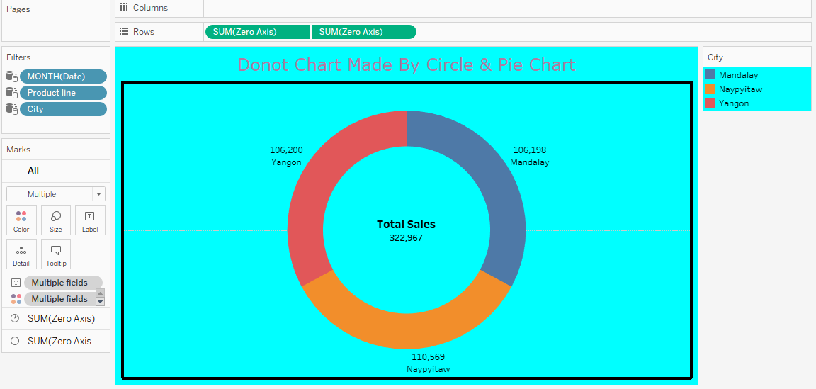
TYPES
Donot Chart

Slide 5
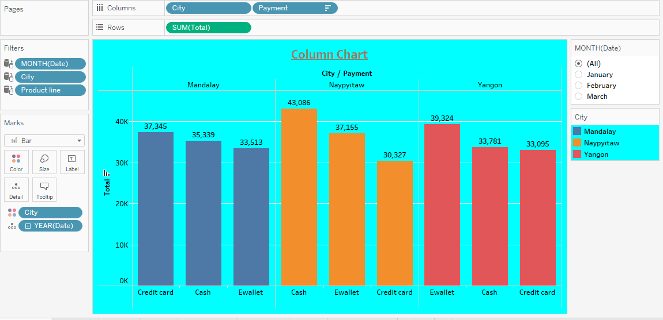
Columns Chart

Slide 6
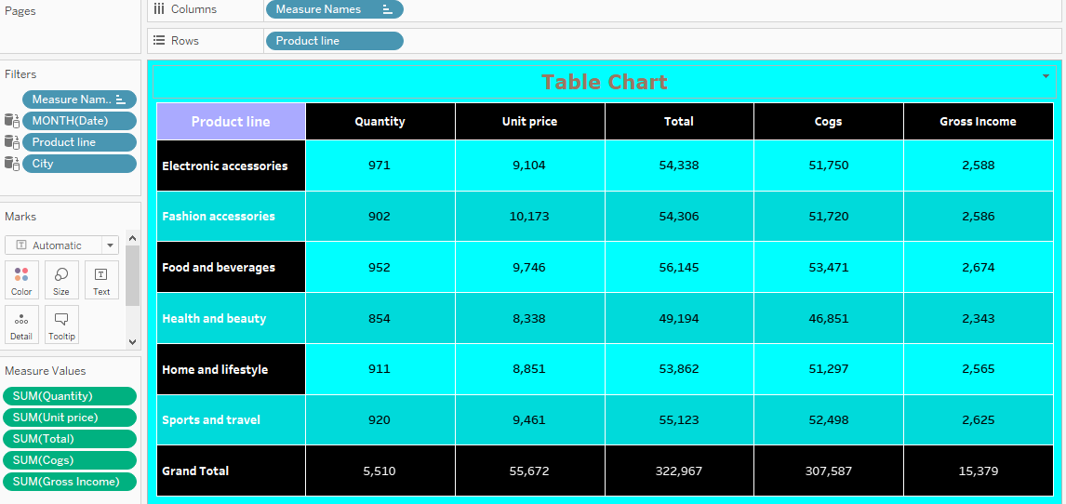
Table Chart

Slide 7
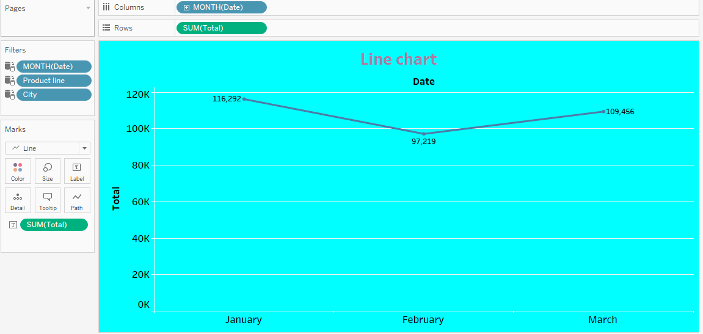
Line Chart

Slide 8
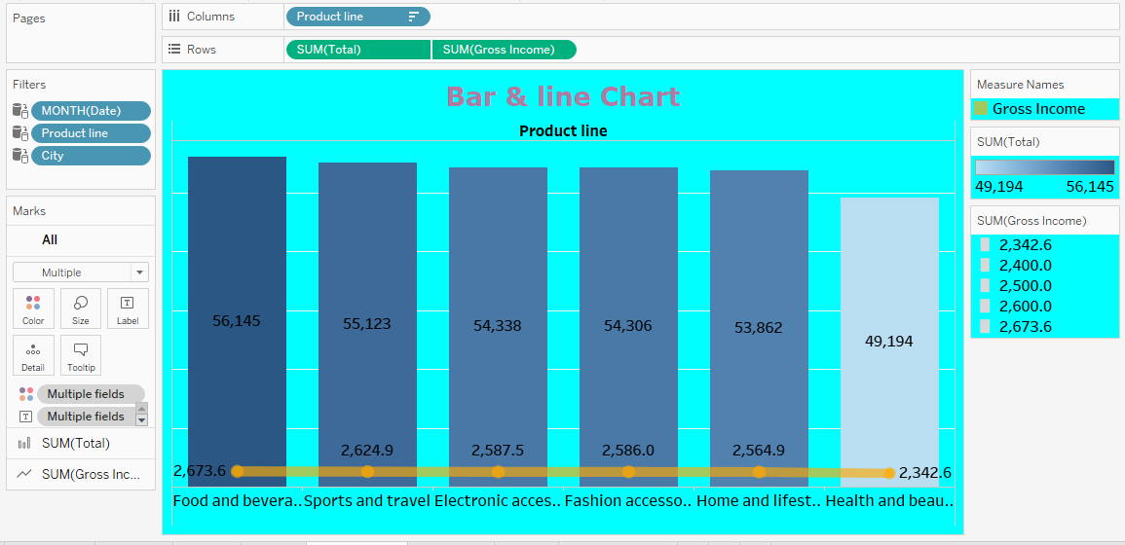
Bar & Line Chart

Slide 9
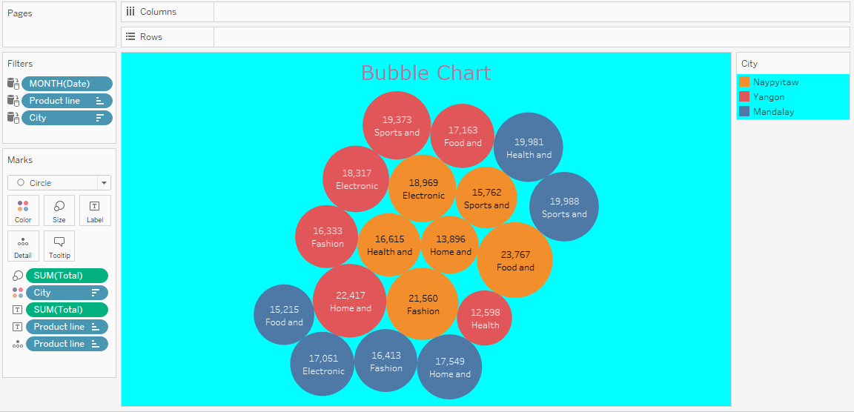
Bubble Chart

Slide 10
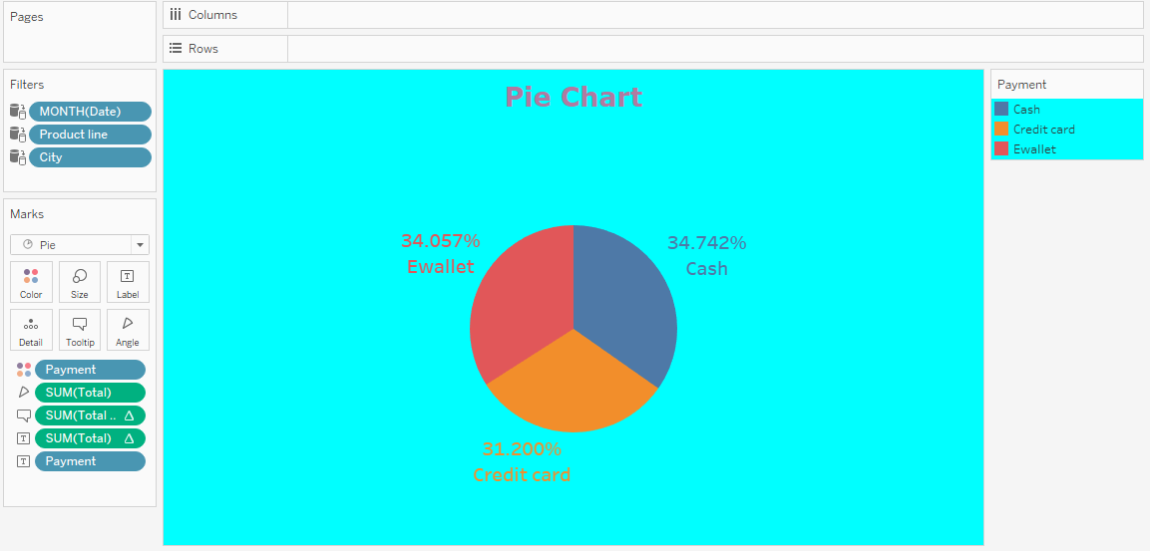
Pie Chart

Slide 11
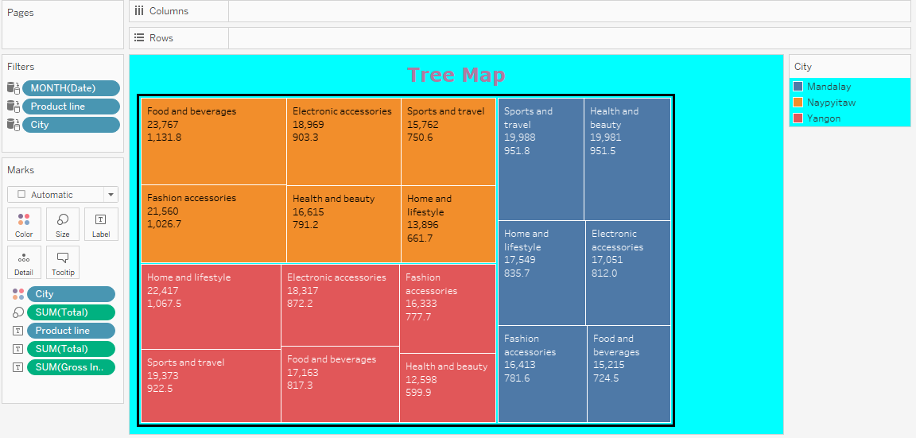
Treemap Chart

Slide 12
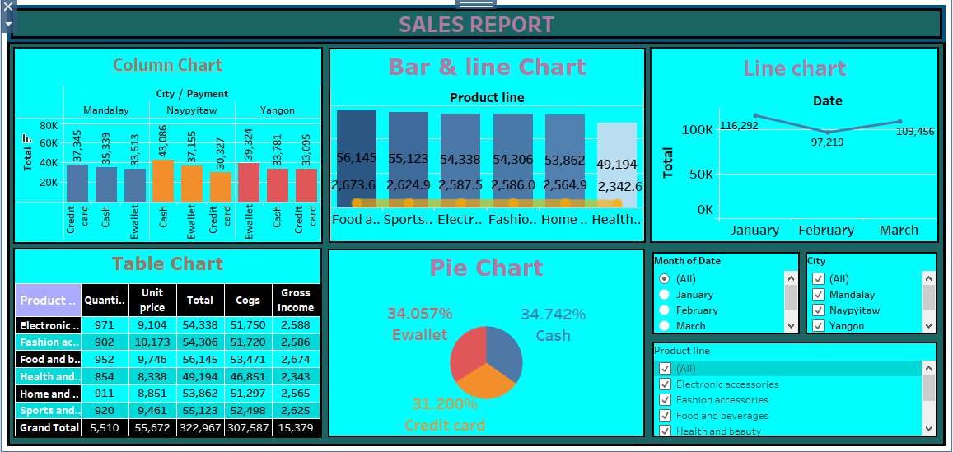
DASHBOARD

Slide 13
THANK YOU

